Slide 1
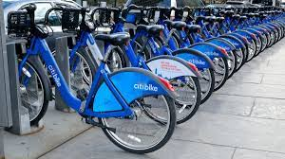
CitiBike Exploratory Data Analysis
By Aidan Pecorale

Slide 2
CitiBike Exploratory Data Analysis
Who?
Who are these riders?
Are they member or casual users?
Which groups ride longer?
Where?
Where are people riding the most?
What stations have bike sinks or overflows?
When?
When are people using the bikes the most?
When don't they use the bikes?
Do certain groups exhibit habits?

Slide 3
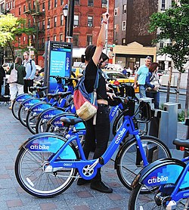
About the Data
Data is collected from CitiBike rides in New York City. This dataset was collected in May of 2021
Fields included in data:
Ride ID, and type
Started Time, End Time
Start Location (Address, ID and Lat/Long)
End Location (Address, ID and Lat/Long)
Type of rider (Member or Casual)

Slide 4
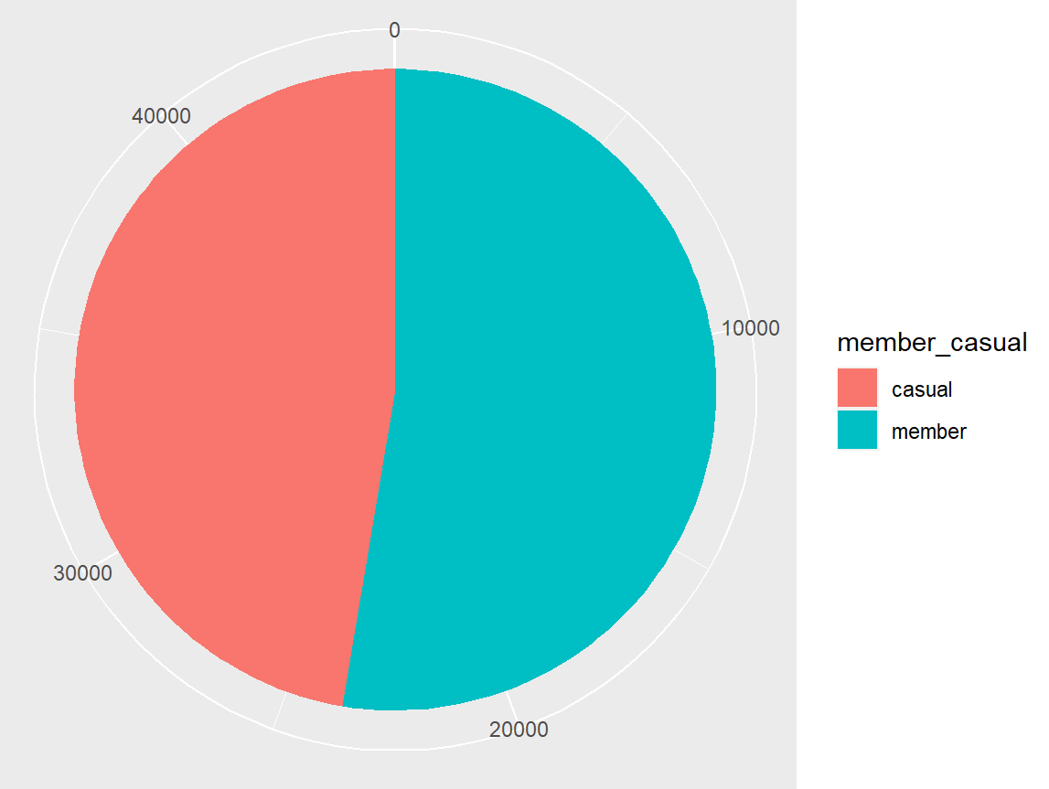
Who uses the bikes?
Citi Bikes have become an essential part transit in New York City for residents and tourists alike.
The two classes of bike users are members and casual users
  Memberships cost $15 a month
  Casual users pay S4 a trip or $15 for a day pass
More than half the users in this dataset are members (but we will see this may be slightly skewed later)

Slide 5
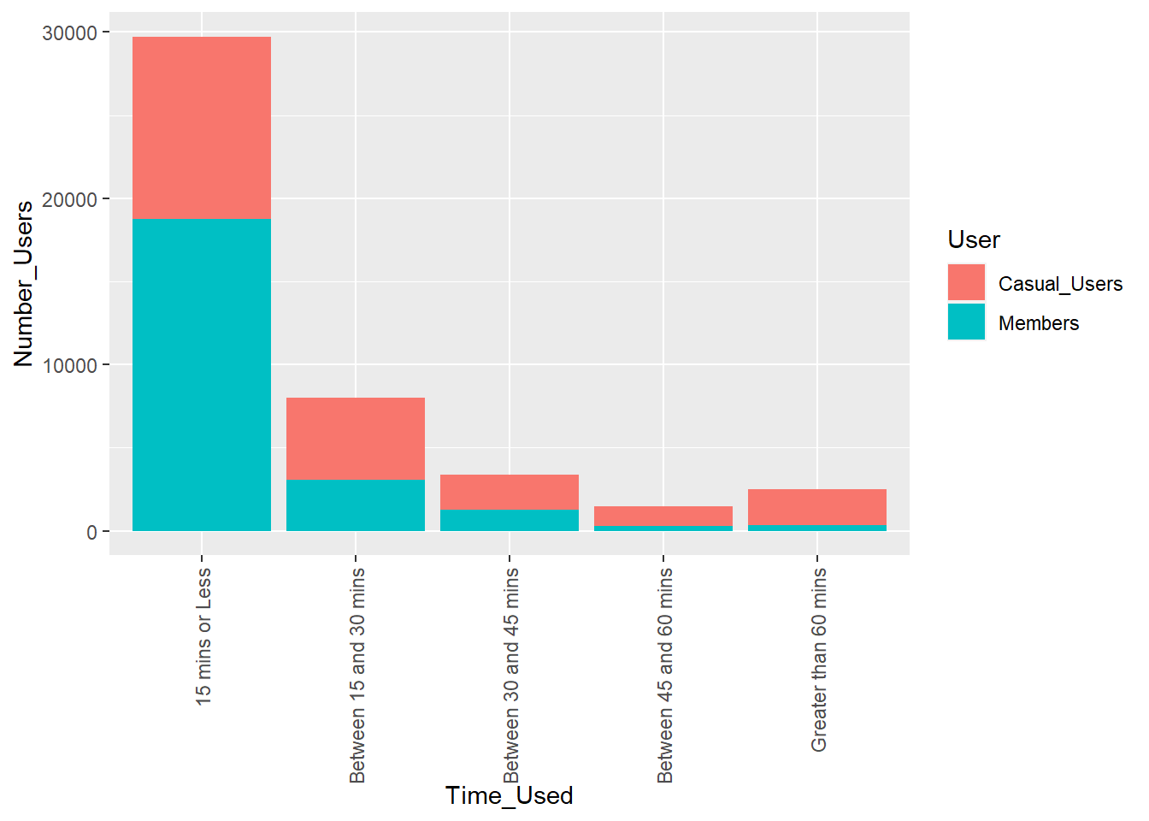
Which group rides longer?
Here we can see a breakdown of total trip times.
As we can see most trips are 15 mins or less with a large drop off after the 30 mins.
Casual incur overage charges after 30 mins while members have 45 mins before being charged, yet we see a larger number of casual users taking trips longer than 45 mins

Slide 6
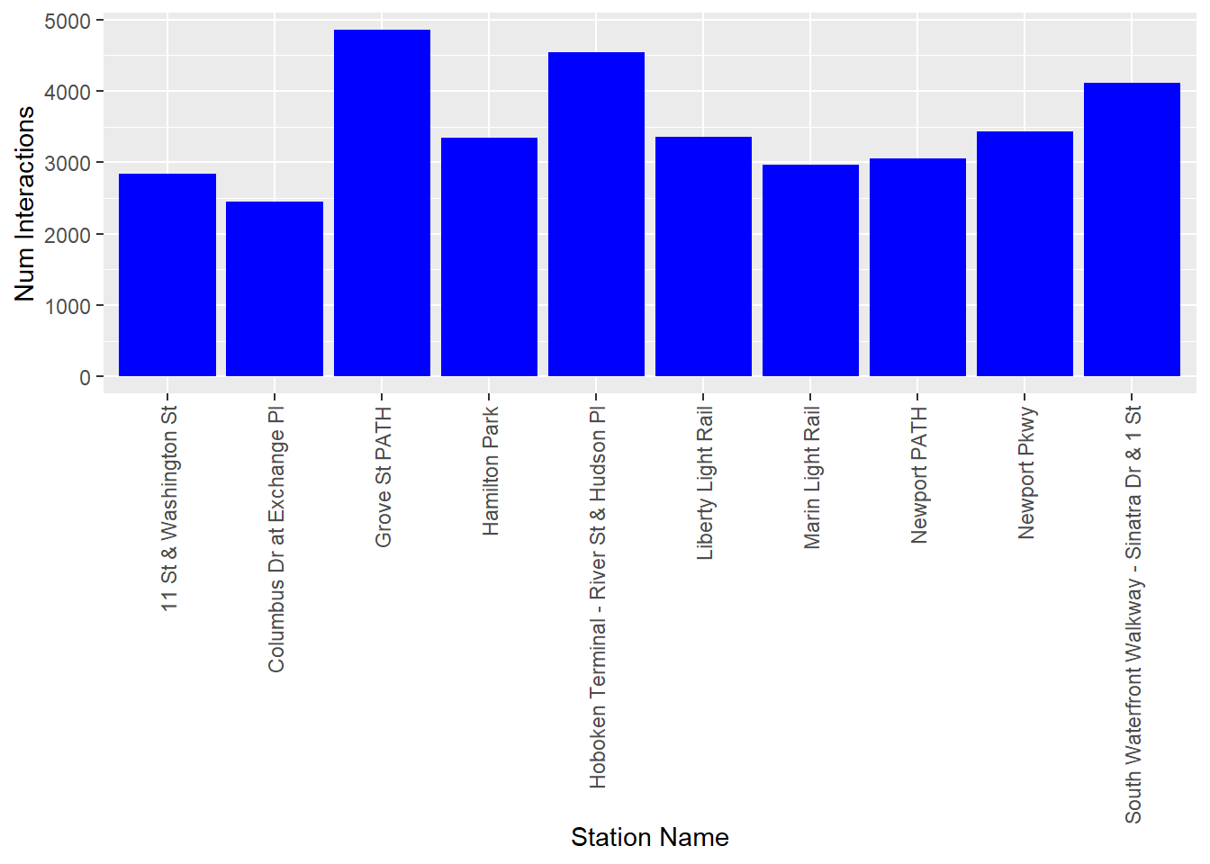
What locations have the most riders?
On question on many people's mind is “Which locations are used the most?”
This data could be useful for CitiBikes to know what locations they need to stock more bikes. Can also use to try and reason why people are using bikes. Ie: by train station may be for work transport or by tourist locations may be more recreational.
Top three:
Grove St. PATH
Hoboken Terminal
South Waterfront Walkway

Slide 7
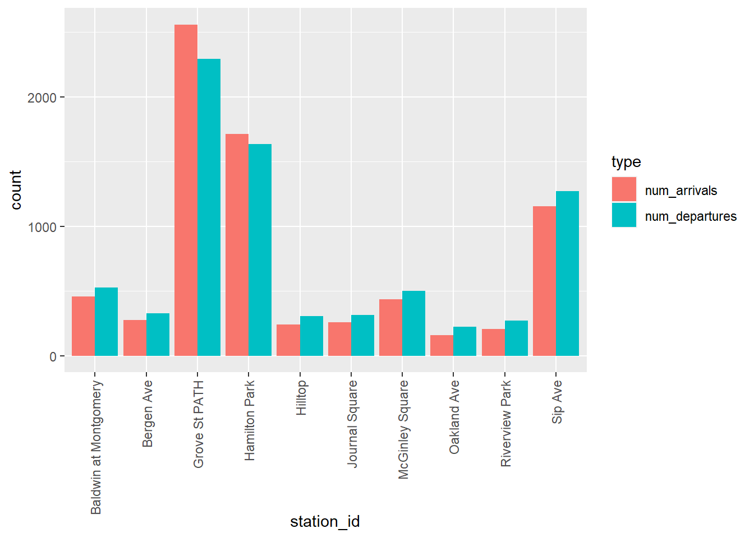
What stations are bike sinks or overflows?
This data may be more helpful for overnight maintenance and redistribution of bikes for next day.
Graph shows stations with over 50 bikes difference between departures and arrivals. Stations with larger number of arrivals than departures may be bike sinks while stations with a higher number of departures may become overflowed with bikes.

Slide 8
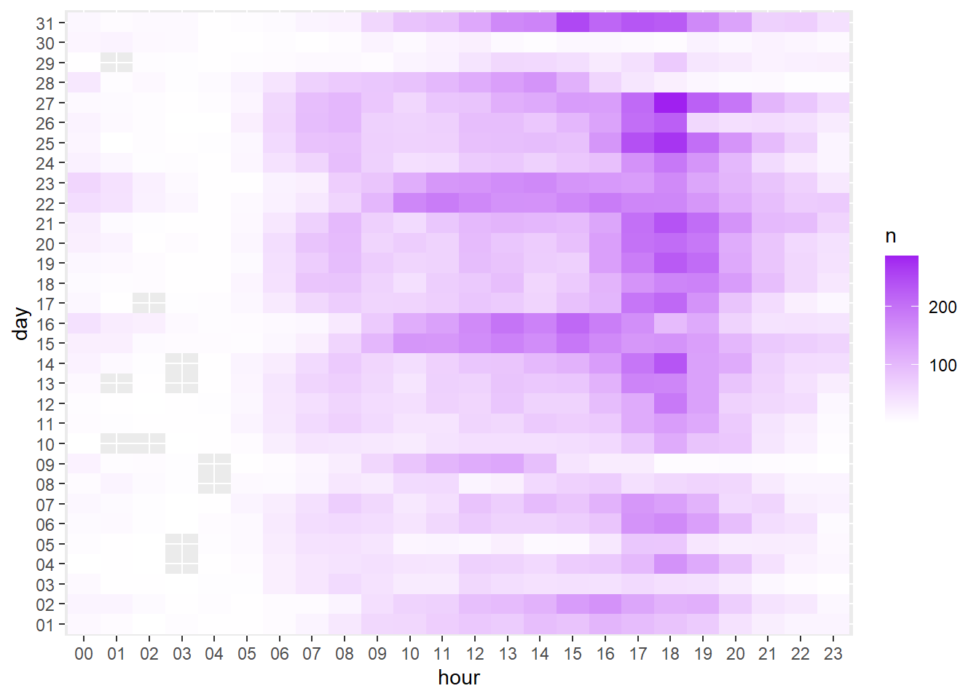
When are people using the bikes the most?
This graph is a heatmap of day and hours that the most number of bikes are used. A couple trends we can see are:
Bikes are more heavily used between 17:00 and 18:00 (possible commuters)
Higher number of use on weekends (see day 15,16 and 22,23)
Possible correlations with weather (29th and 30th had poor numbers and further research showed rain those days)

Slide 9
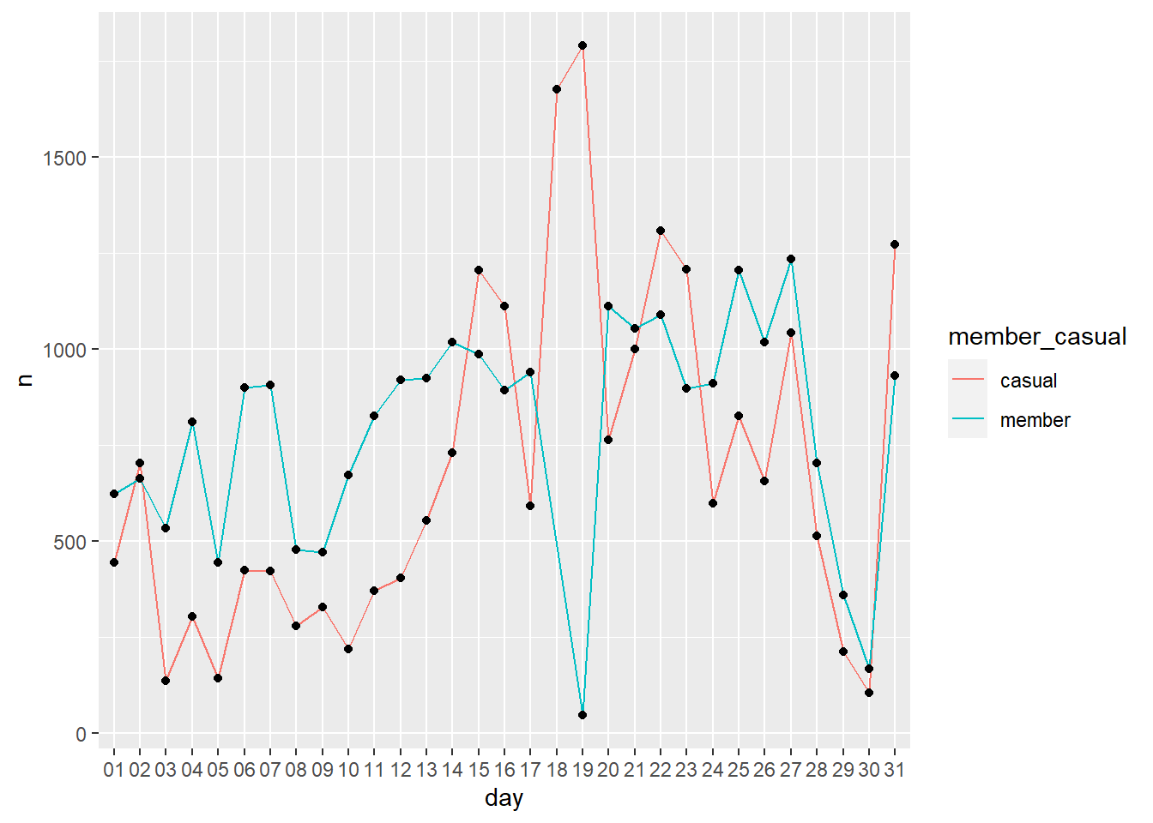
Which groups use bikes more based on day?
What days did members ride more?
Members use bike more during week and casual users us more on weekend (see 15th/16th and 22nd/23rd)
Spike of casual users on 18th and 19th (research shows Amazon outage affected Members bike usability so registered as casual for outage)
Casual riders less likely to use bikes in poor weather (see 3rd and 8th)

Slide 10
Conclusions
Citi bikes usage is a interesting dataset that can tell the stories of New Yorkers through a new lens from popular locations to showing their mobility.
Members generally use the service more especially on weekdays while casual users out number them on weekends.
Casual riders generally spend longer on rides then members despite incurring more overage charges
With little surprise there seems to be a correlation between the weather and number of riders.

Slide 11
Future Research
Some ideas for possible future research with the dataset include:
Including more datasets from other months or years to see bigger trends.
Better combine data with weather or holiday/events going on in city.
Visualize locations on map / analyze distances rode or common trip paths.

